Slide 1


Data Analysis on Social Buzz User Data

Slide 2
Today's agenda
Project recap
Problem
The Analytics team
Process
Insights
Summary

Slide 3

“Social Buzz” is a rapidly expanding technology unicorn that needs to adapt swiftly to its global scale. Accenture proposed a three-month Proof of Concept (POC) that will concentrate on the following initiatives:
An audit of their big data practice
Recommendations for a successful IPO
An analysis of their content categories that highlights the top 5 categories with the
largest aggregate popularity
Project Recap

Slide 4


Problem
Over 100,000 posts per day
Over 36,500,000 posts per year
The challenge lies in harnessing this vast data resources effectively.
The goal is to analyze and identify Social Buzz's top 5 most popular content
Categories of content.

Slide 5




ANDREW FLEMING
Chief Technology
Architect
The Analytics team
MARCUS ROMPTON
Senior Principal
Aashritha Venepally
Data Analyst

Slide 6
Process
1
Understanding the Data
2
Data Cleaning
3
Data Modelling
4
Data Analysis
5
Uncover Insights

Slide 7

Insights
How many unique categories are there?
How many reactions are there to the most popular category?
What was the month with the most posts?
Unique Categories
16
Reactions to “ANIMAL” Posts
1897
Month with most posts
MAY

Slide 8
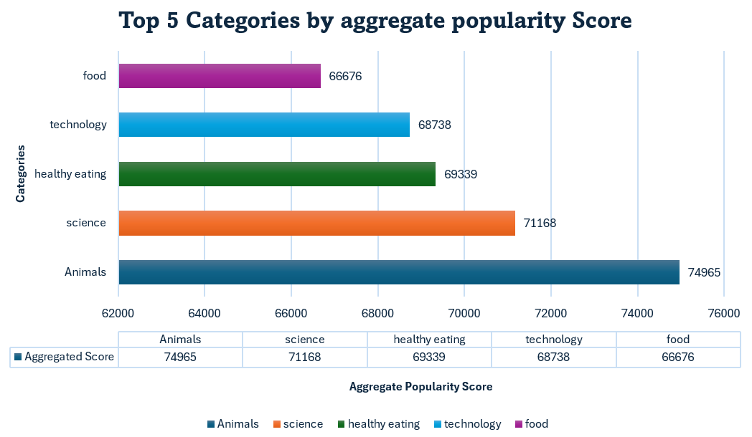

Slide 10


The top 5 most popular categories of posts were Animals, Science, Healthy Eating, Technology and Food.
“Animals” has a greater number of reactions i.e 1897.
Summary
Month of “MAY” has greater number of Posts.
Next Steps: While this ad hoc analysis is insightful, it is important and timely to take this further for real time understanding of the business. We can work with you and show you how this can be achieved.

Slide 11
Thank you!
ANY QUESTIONS?

